Slide 1
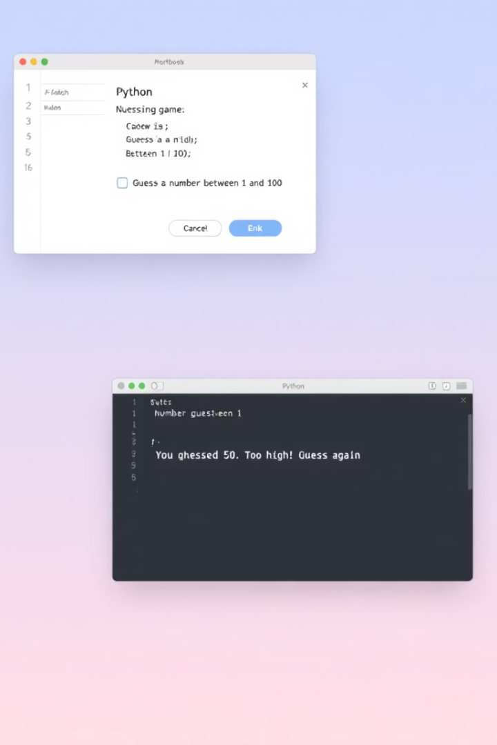
The Number Guessing Game in Python
An interactive game where players try to guess a randomly generated number within a specified range and limited attempts.

Slide 2

Game Overview
Secret Number
Defined Range
Limited Attempts
Computer randomly generates a number that players must guess.
Players guess within boundaries, typically between 1 and 100.
A set number of guesses creates challenge and excitement.

Slide 3




How the Game Works
Player Input
User enters their guess using the keyboard.
Game Feedback
The system replies with "too high," "too low," or "correct!"
Game Conclusion
The game ends when the guess is correct or all attempts are used.

Slide 4







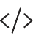
Core Python Logic
Random Number Generation
Input Validation
Ensures guesses are integers within the specified range.
Uses random.randint() to create the secret number.
Attempt Tracking
Conditional Logic
Counts and limits the number of guesses allowed.
Compares guess to secret number and provides feedback.

Slide 5

Sample Python Code
Game Loop
Number Generation
Process guesses and provide feedback until win or lose.
Setup
Create the secret number for the player to guess.
Import random module and define game parameters.
secret = random.randint(lower, upper)
for attempt in range(max_attempts):
guess = int(input("Your guess: "))
if guess == secret:
print("Correct!")
break
elif guess < secret:
print("Too low!")
else:
print("Too high!")
import random
lower, upper = 1, 100
max_attempts = 7

Slide 6
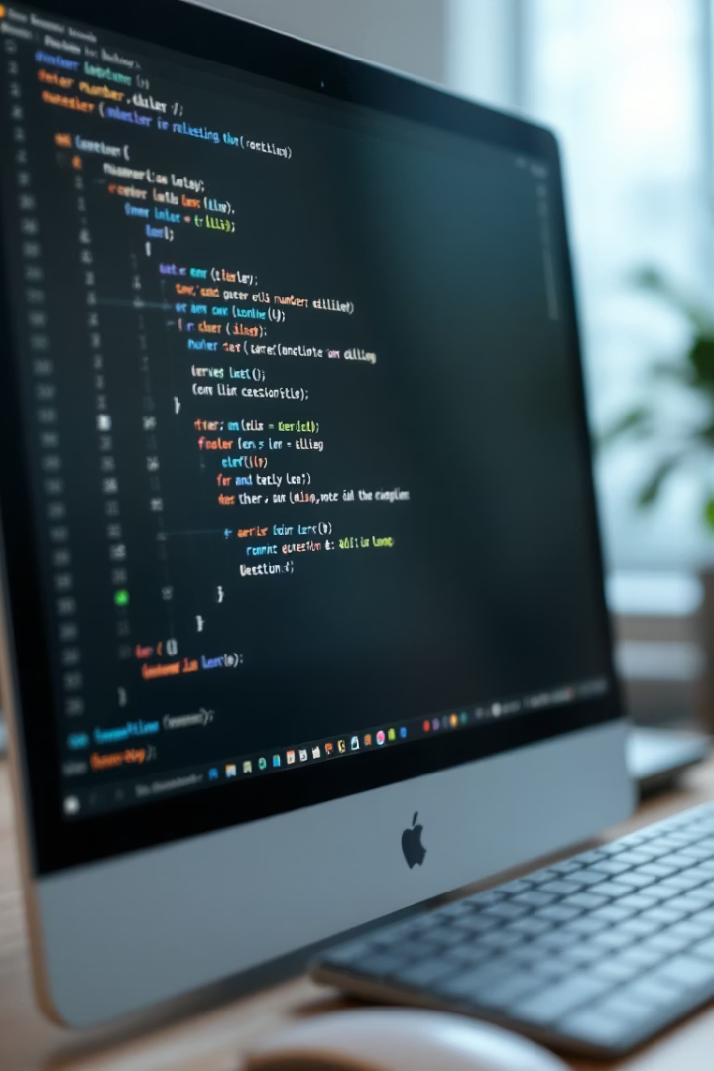
Sample Gameplay Walkthrough
1
Game Start
"Guess a number between 1 and 100. You have 7 attempts."
2
First Guess: 50
"Too low! Try a higher number."
3
Second Guess: 75
"Too high! Try a lower number."
4
Third Guess: 63
"Correct! You guessed the number in 3 attempts!"

Slide 7





Why It's Engaging and Educational
Programming Fundamentals
Teaches loops, conditionals, random number generation, and user input handling.
Problem-Solving Skills
Develops logical thinking and strategic approaches to finding the answer.
Customizable Difficulty
Easily adjust number range and attempts to match skill levels.
Immediate Feedback
Quick responses keep players engaged and learning from each guess.

Slide 8






Conclusion: Fun and Versatile Game
Entertainment Value
Simple yet addictive gameplay for all ages
Coding Practice
Perfect project for beginners learning Python
Customization Options
Expandable with features like score tracking and difficulty levels

